Slide 1
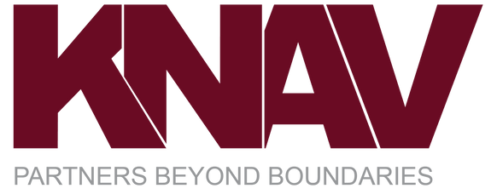



About KNAV
GROW YOUR BUSINESS
Organisation Delvelopment Workshop
Username
Organization name
Password
Get Started
Remember me
Need Help?

Slide 2

Home
Welcome [Name] to KNAV’s Grow Your Business: Organization Development Workshop

Slide 3

ABOUT US
Home
KNAV is a more than two decades experienced firm of international accountants, tax advisors and business advisors, jointly headquartered in Mumbai (India) and Atlanta (USA). We are present in seven countries worldwide, namely India, Canada, Netherlands, Singapore, Philippines, the UK, and the US.
In the ever-changing business landscape, adaptability is crucial. KNAV’s Organization Development Workshop offers a collaborative platform for startups, mid-sized enterprises, and established firms. We help businesses align goals, engage stakeholders, and chart a unified course forward in today's resilient-focused environment.
KNAV’s Organization Development & Business Planning Workshop is aimed at identifying business pain points and mapping a clear roadmap to the business vision. Guided by KNAV experts, participants shall analyze major business facets to uncover strengths, weaknesses, opportunities, and threats. Our common goal is to facilitate strategic exploration to unlock the business' full potential.
This collaborative workshop encourages active engagement and idea-sharing among management stakeholders, fostering a supportive environment where breakthroughs occur. Our proprietary application, "Grow Your Business," streamlines management inputs, generating tailored reports to highlight areas for improvement. By identifying key growth drivers and problem points, businesses emerge more aligned and aware, ready to take action.
Grow Your Business: organization Development Workshop
Next

Slide 4

[Name]
Logout
Home
[Organization Name]
KNAV BAS OD
Vision And Mission Statement
Questionnaire
List of Actionables
Workshop Feedback
Grow Your Business: organization Development Workshop

Slide 5
[Name]
Logout
Home
[Organization Name]
KNAV BAS OD
Pre-Organization Development Workshop
Vision & Mission
Unlock Value
Setting context before the Organization Development Workshop.
Aligning goals, purpose, and aspirations for the business.
Foundational insights on the business model, operational efficiency and strategic outlook.
Actionables
Reports
Track key priorities & takeaways from the Organization Development Workshop.
Summary of key insights, participant reflections & actionables.
Grow Your Business: organization Development Workshop

Slide 6

[Name]
Logout
Home
[Organization Name]
KNAV BAS OD
Unlock Value
Actionables
Reports
Pre-Organization Development Workshop
Vision & Mission
Unlock Value
Setting context before the Organization Development Workshop.
Aligning goals, purpose, and aspirations for the business.
Foundational insights on the business model, operational efficiency and strategic outlook.
Actionables
Reports
Track key priorities & takeaways from the Organization Development Workshop.
Summary of key insights, participant reflections & actionables.
Back
Grow Your Business: organization Development Workshop

Slide 7

[Name]
Logout
Home
[Organization Name]
KNAV BAS OD
Unlock Value
Category
Marketing & Sales
Category
Pre-Organization Development Workshop
Vision & Mission
Unlock Value
Category
Setting context before the Organization Development Workshop.
Aligning goals, purpose, and aspirations for the business.
Foundational insights on the business model, operational efficiency and strategic outlook.
Category
Category
Category
Category
Actionables
Reports
Track key priorities & takeaways from the Organization Development Workshop.
Summary of key insights, participant reflections & actionables.
Actionables
Reports
Back
Grow Your Business: organization Development Workshop

Slide 8
[Name]
Logout
Home
[Organization Name]
KNAV BAS OD
Sr.No.
Question
Question Tag
1
Focus on most profitable products and services
Customer Strategy, relationships & Interactions
2
Focus on most effective sales & advertising channels
Customer Strategy, relationships & Interactions
3
Target new geographies
Customer Strategy, relationships & Interactions
4
Target new segments within current geographies
Customer Strategy, relationships & Interactions
5
Improve total customer experience(Purchasing, fulfilment, Usage support, Service, Availability etc.)
Customer Strategy, relationships & Interactions
6
Improve brand strength & goodwill
Customer Strategy, relationships & Interactions
Grow Your Business: organization Development Workshop

